Slide 1

Olessia Bauer report
April 2026

Slide 2

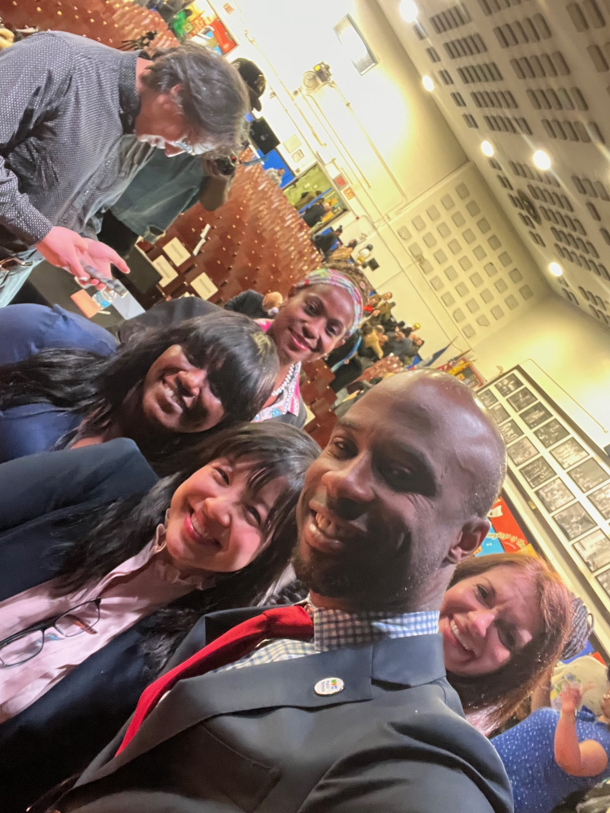
Chancellor Town Hall @ M.S. 217
March 16th
Olessia.bauer.cec28@gmail.com
Over 800 people attended (700+ virtually)
7 Questions answered
All other questions forwarded to Superintendent’s office

Slide 3
Empowering Parent Leaders
(brainstorming meeting recap)
Olessia.bauer.cec28@gmail.com
Sonia Ruenda, Family Leadership Coordinator District 28
Sasha Cruz, Title I chair at P.S. 139, PTA and SLT member
Gizelle Mendosa, President of Presidents Council District 28
Mandatory training
Centralized orientation and onboarding process ("welcome packets”)
Stakeholder Collaboration
Resource Accessibility
Individual parent leaders accounts

Slide 4
Empowering parent leaders
Olessia.bauer.cec28@gmail.com
Lead | Task | Timeline
Sonia | Create a centralized resource packet for the district website. | Post-Election
Sonia | Conduct English/Spanish info sessions on leadership roles. | Completed
Sonia | Revamp Title I information and outreach. | End of April
Olessia | Forward meeting highlights to Deputy Chancellor Floria Puello. | End of April
Giselle | Send flyer for the May 2nd community event to Sonia. | End of April
Sasha | Coordinate with Sonia on the late April/early May Resource Day. | Upcoming

Slide 5
M.S. 217, March SLT meeting
Olessia.bauer.cec28@gmail.com
Student tardiness
Urban and school garden
Bus stop petition
Water bottles and headphones for every student
SLT meetings translated to Spanish
T-building – outside paint
Boys locker room weight room and wood shop
Girls locker room STEM lab

Slide 6
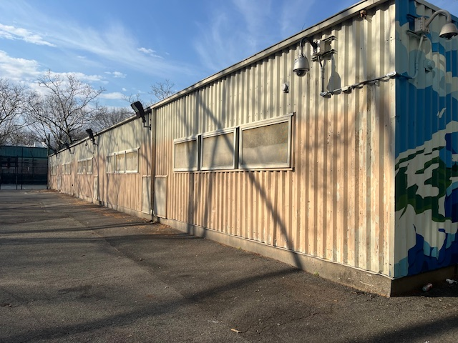
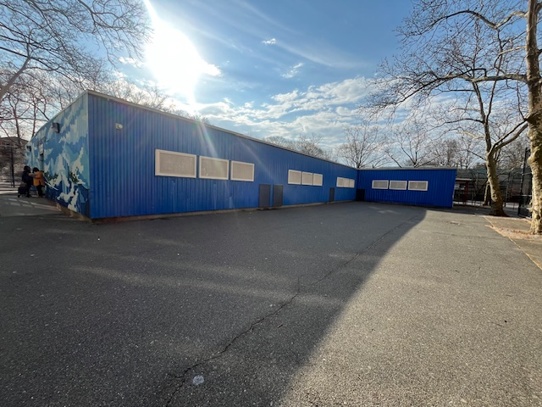
M.S. 217
Olessia.bauer.cec28@gmail.com
Before
After

Slide 7

M.S. 287 project updates
Olessia.bauer.cec28@gmail.com
1. HVAC system installation sponsored by Reso A, budget is $550,000 (start date and other details are needed). Per SCA this scope will begin in 2026.
2. Jamaica Neighborhood Plan (more details are needed). There are no details to share as this a Department of City Planning project. The Office of the Queens Borough President has been involved, and we have relayed a number of schools within the perimeters of the plan.
3. Gym renovation sponsored by Natasha Williams, budget is $2,000,000 (start date and other details are needed). Given that this is not a project, SCA has not relayed this information. However, happy to inquire.
4. Restroom upgrades sponsored by a Council Member, approved in November, budget is $1,500,000 (start date and other details are needed). Given that this is not a project, SCA has not relayed this information. However, happy to inquire.
Projects 3 & 4 are both funded under the Jamaica Neighborhood plan. Once funding is released to SCA we will reach out to schools quickly to begin planning.

Slide 8
M.S. 287 project updates
Olessia.bauer.cec28@gmail.com
1. HVAC system - Reso A, work begins in April 23rd, 2026
2. Gym renovation and Restroom upgrades - Jamaica Neighborhood Plan – work begins in April – May 2026
3. New windows – city approval pending

Slide 9
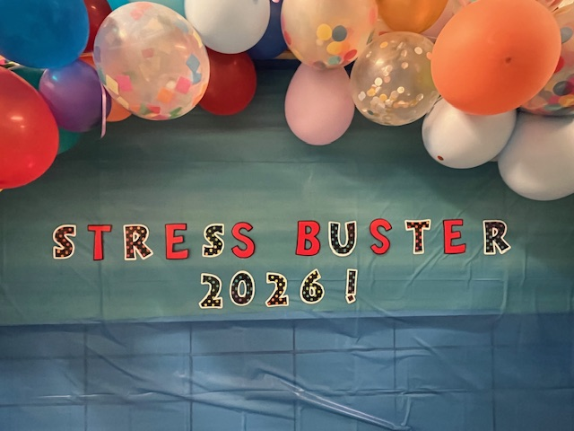
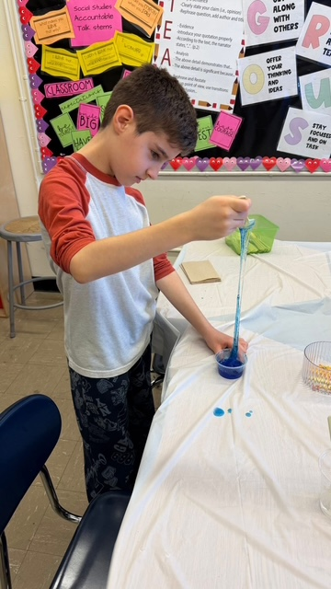
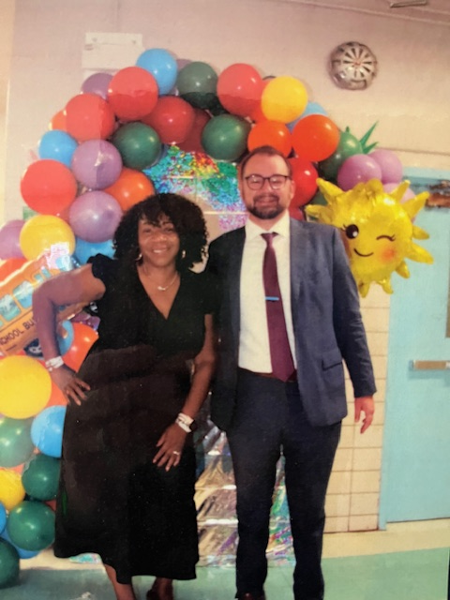
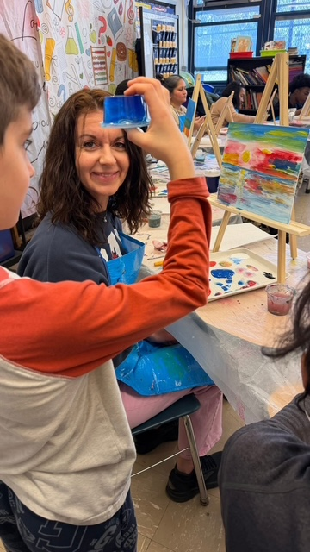
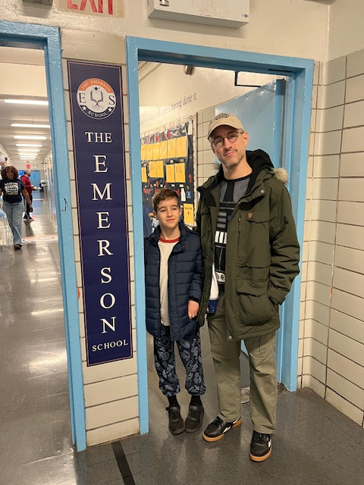
Olessia.bauer.cec28@gamil.com

Slide 10

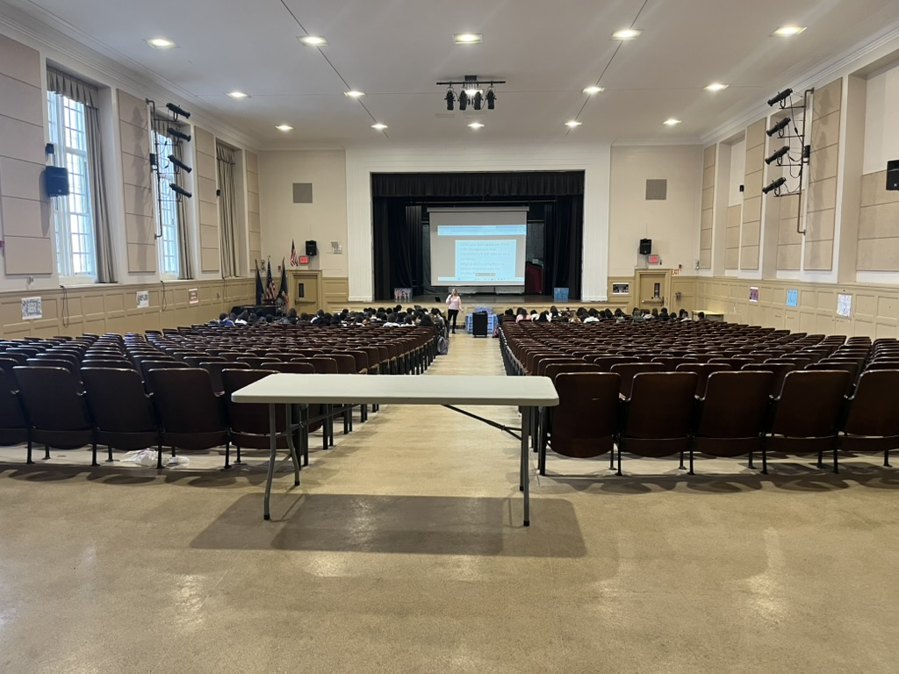
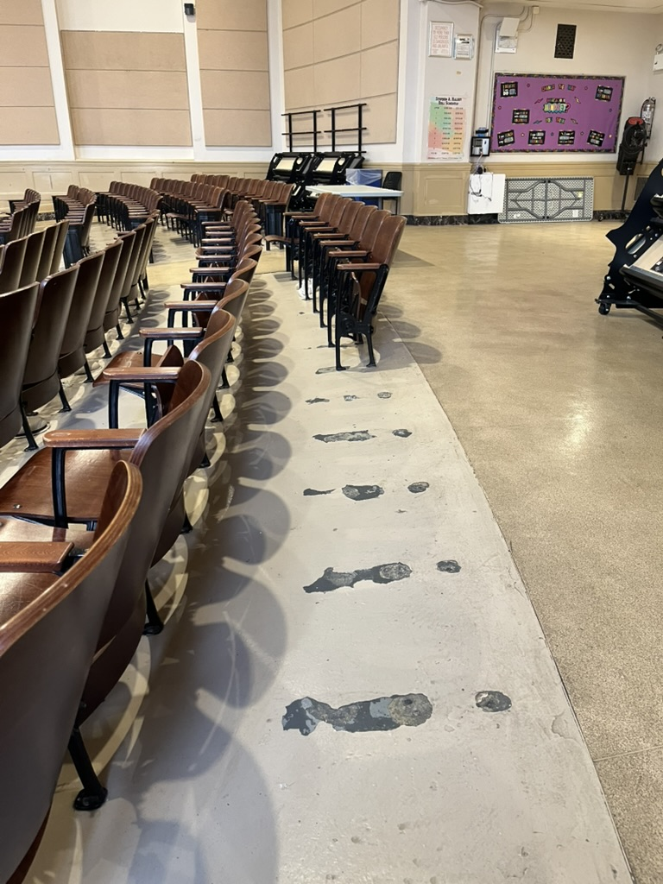
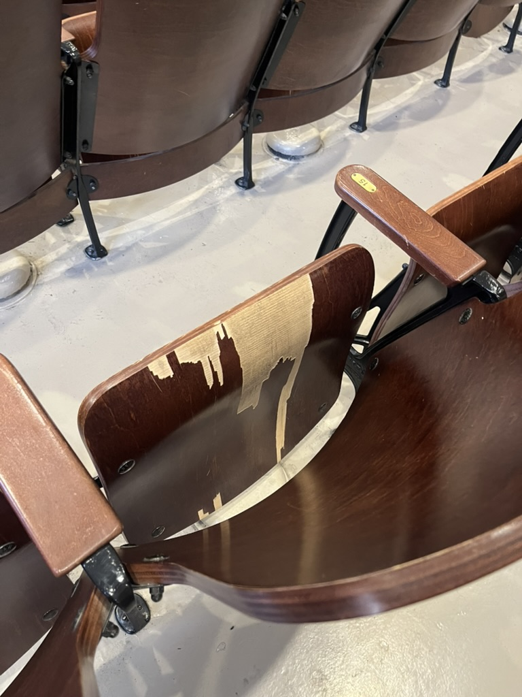
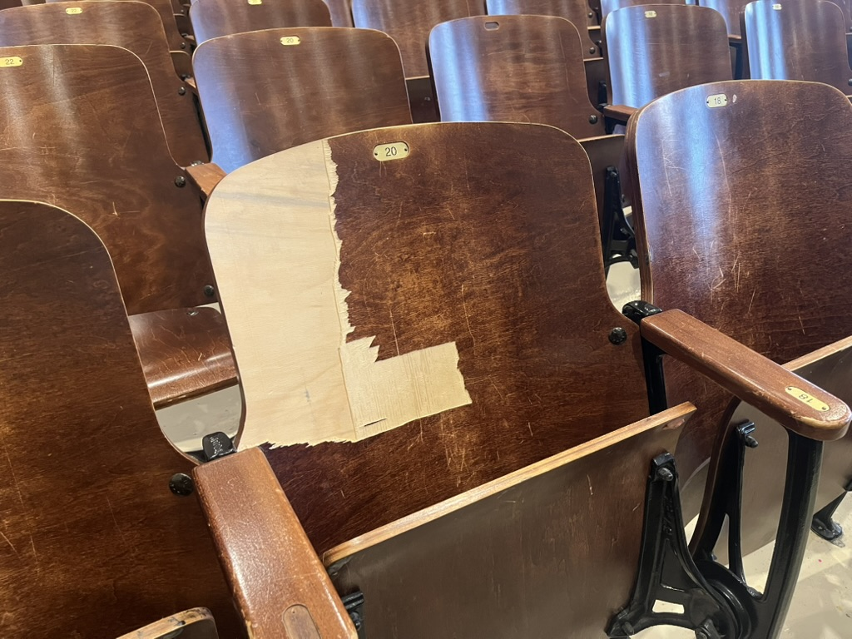
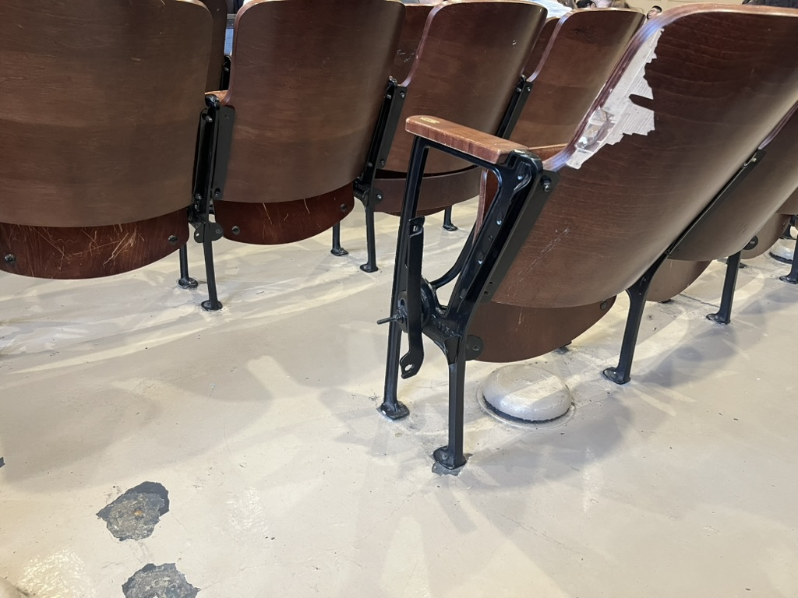
J.H.S 157 Auditorium visit
Olessia.bauer.cec28@gamil.com
Complete renovation of the auditorium was requested by the Principal through CEC28 capital projects support in January 2026:
Most chairs are broken
New sound, and lighting systems, projections system, a/c, and new seating are needed.

Slide 11
J.H.S 157 April SLT meeting
Olessia.bauer.cec28@gamil.com
Perfect Attendance is growing
Regents test (online prep courses)
Cafeteria upgrade starts April 30th – lunch plan – testing date May 1st – upgrade complete May 4th

